Slide 1



HumanNeRF-SE: A Simple yet Effective Approach
to Animate HumanNeRF with Diverse Poses
Diffusion
Caoyuan Ma
AIM Lab, Wuhan University
EVOL Lab, TeleAI, China Telecom

Slide 2
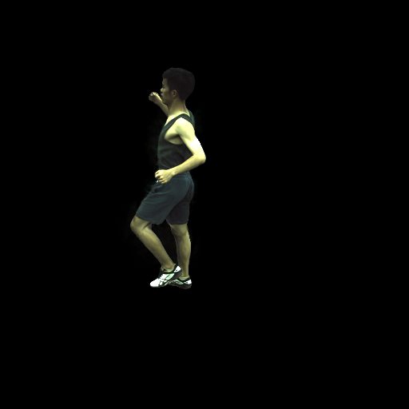
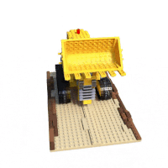
Tasks
Free-viewpoint Rendering of Moving People
from Monocular Video by NeRF
Camera input Image output
NeRF ｜HumanNeRF
｜
Dense view｜Single view
Static objects ｜ Moving People
Notes:
说到自由视角合成，不能不提大火的nerf，那这个工作也是基于nerf开展的，和nerf的不同是，nerf采用稠密的静态视图来建模空间，而humannerf使用单目视频。Nerf的对象是静态物体，而huannerf的对象是一个动态的人物。
1min：方法是基于nerf的，不同之处在于目标是单摄像头下的运动人体

Slide 3
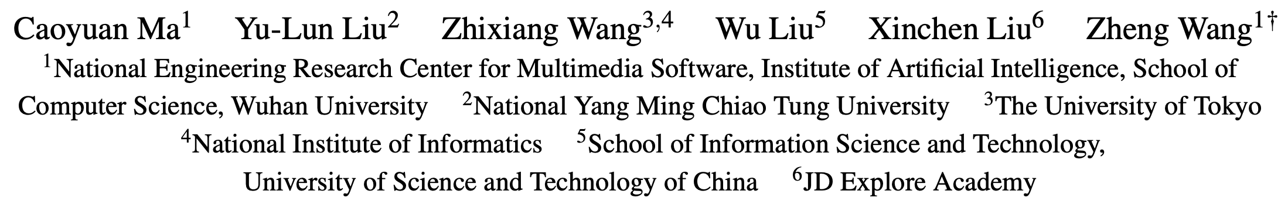
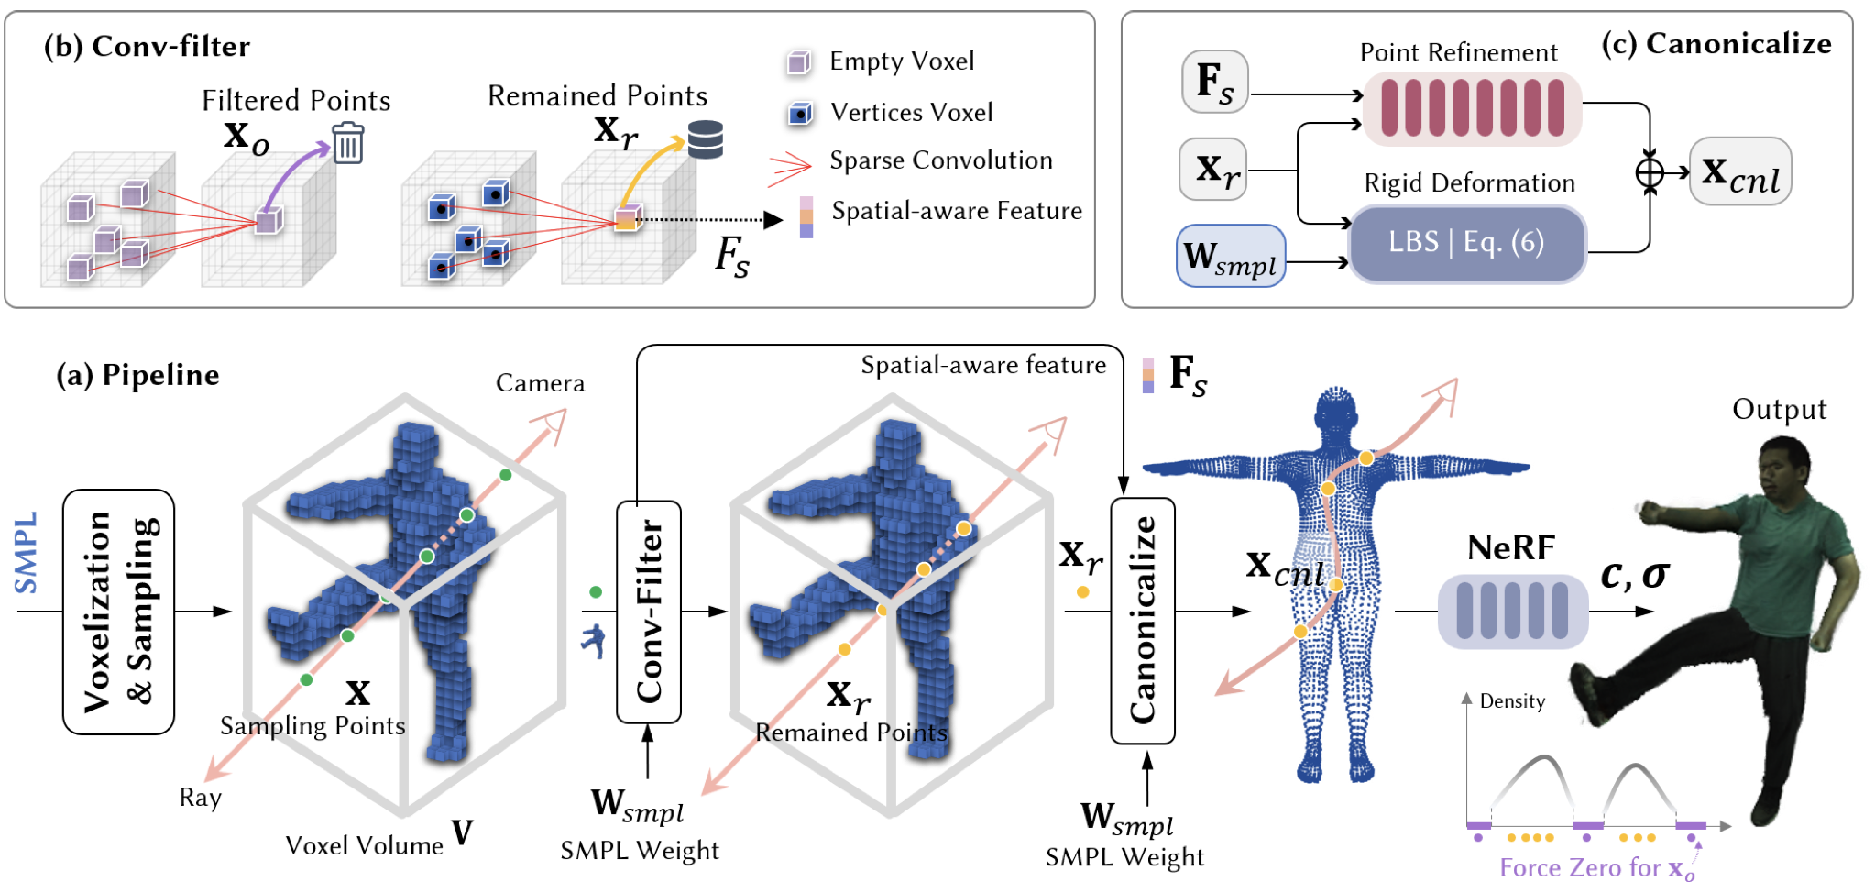
HumanNeRF-SE: A Simple yet Effective Approach
to Animate HumanNeRF with Diverse Poses

Slide 4
HumanNeRF-SE: A Simple yet Effective Approach
to Animate HumanNeRF with Diverse Poses

Slide 5
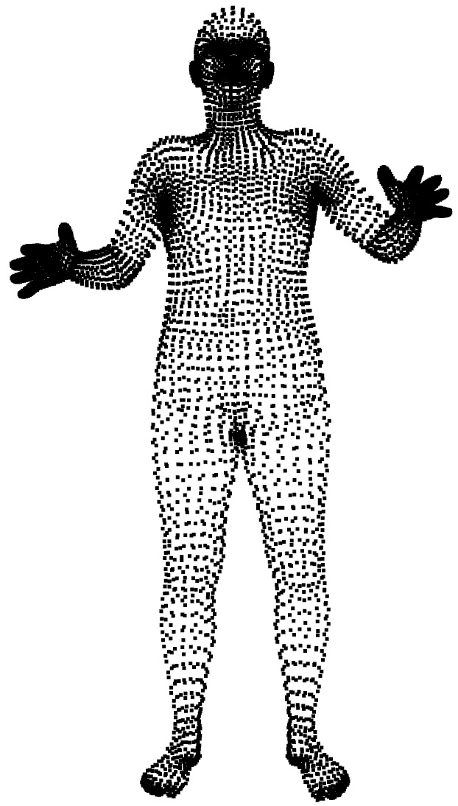
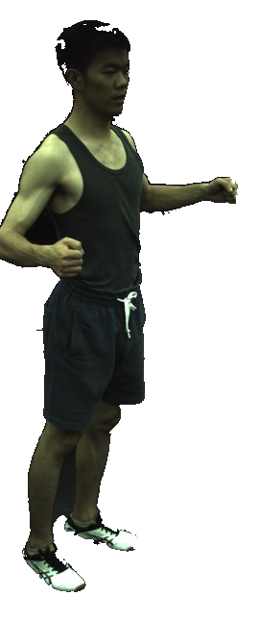
HumanNeRF-SE: A Simple yet Effective Approach to Animate HumanNeRF with Diverse Poses
Camera
receptive field
Normalized and Query
(0, 0, ……, 0)
Occupancy
Filtered out
(5.78, 0.3553, ……, 0.000)
Occupancy
Spatial aware feature

Slide 6
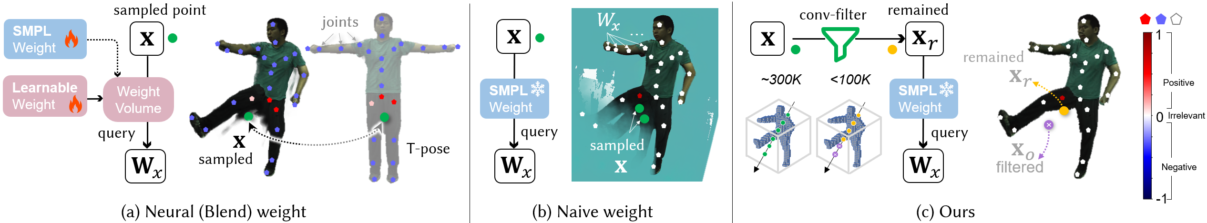
HumanNeRF-SE: A Simple yet Effective Approach to Animate HumanNeRF with Diverse Poses

Slide 7
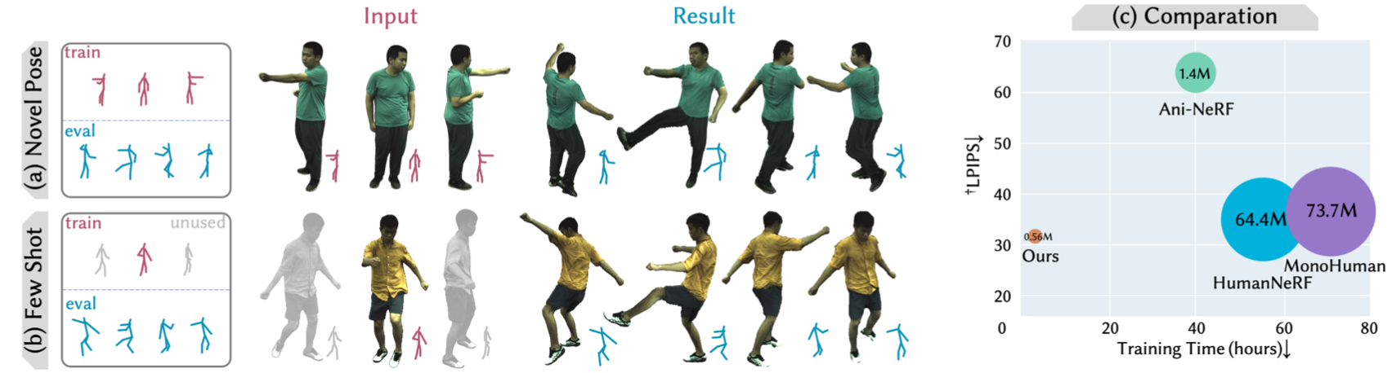
HumanNeRF-SE: A Simple yet Effective Approach to Animate HumanNeRF with Diverse Poses
1. Less than 1% learnable parameters, 1/20 train time.
2. Better performance on novel pose image.
3. With few shot images for train.

Slide 8
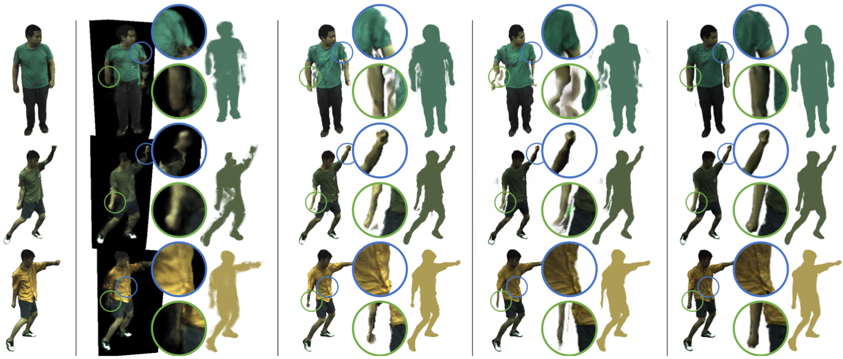
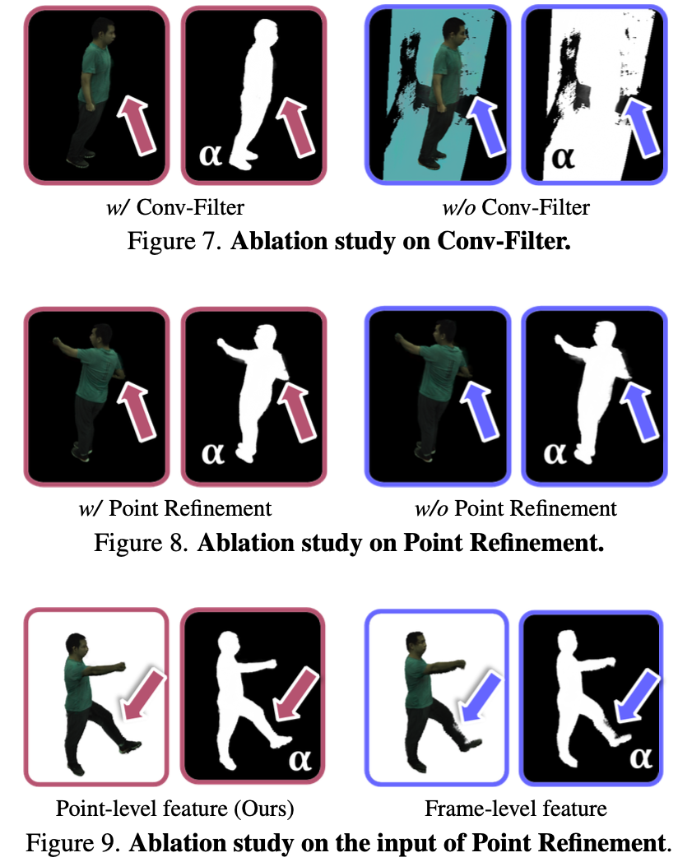

Slide 9
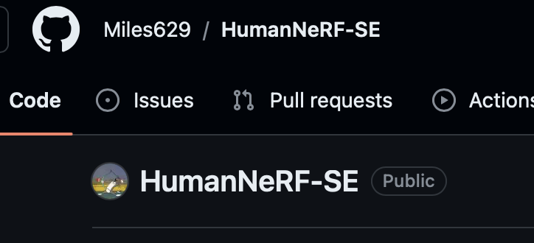

GitHub 搜索“HumanNeRF-SE”
Star 🌟一下谢谢喵～
https://miles629.github.io/humannerf-se.github.io/

Slide 10
Diffusion的发展
VAE Diffusion Model VQ-VAE DDPM DALL-E Diffusion Beat GANs LDM
13 15 17 20 21.1 21.5 21.12
DALL-E2 Imagen SD SD2 DiTs SDXL DALL-E3 SDXL-Turbo SD3
22.4 22.5 22.8 22.11 22.12 23.7 23.9 23.11 24.2

Slide 11
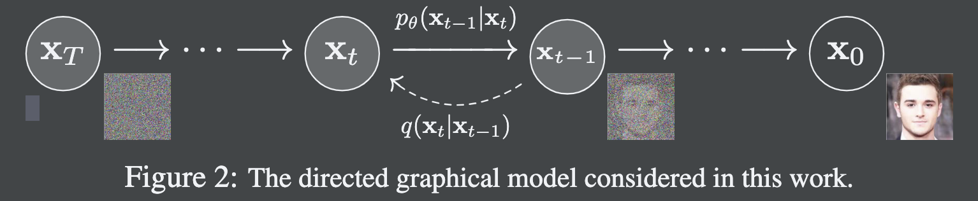
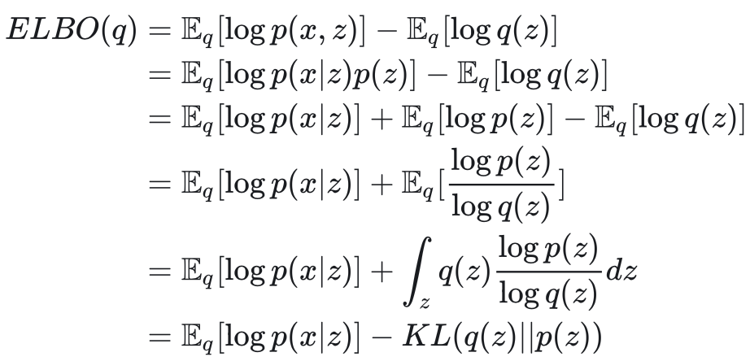
《Denoising Diffusion Probabilistic Models》（DDPM）
Diffusion probabilistic model
A parameterized Markov chain trained using
variational inference to produce samples matching
the data after finite time.
Parameterized Markov Chain
Variational Inference
Evidence Lower Bond 琴生不等式/KL散度表达式

Slide 12
DM的特性和总结：
(1)正向扩散过程——变分推理中的推理模型，是固定的，非常简单;
(2)生成模型是马尔可夫的——每个变量的每个(时间索引)层只根据前一层的条件生成;
(3)参数共享——生成模型的所有步骤共享相同的参数。
正向过程 (1) 和生成模型 (2) 的马尔可夫性质的简单性允许证据下界 (ELBO) 表示为对随机变量层的期望，即从随机过程的角度随时间的期望。
由于生成模型（3）中的大量参数共享，这种期望可以通过单个蒙特卡罗样本有效地估计。
这些属性使扩散模型具有高度可扩展性和灵活性。

Slide 13
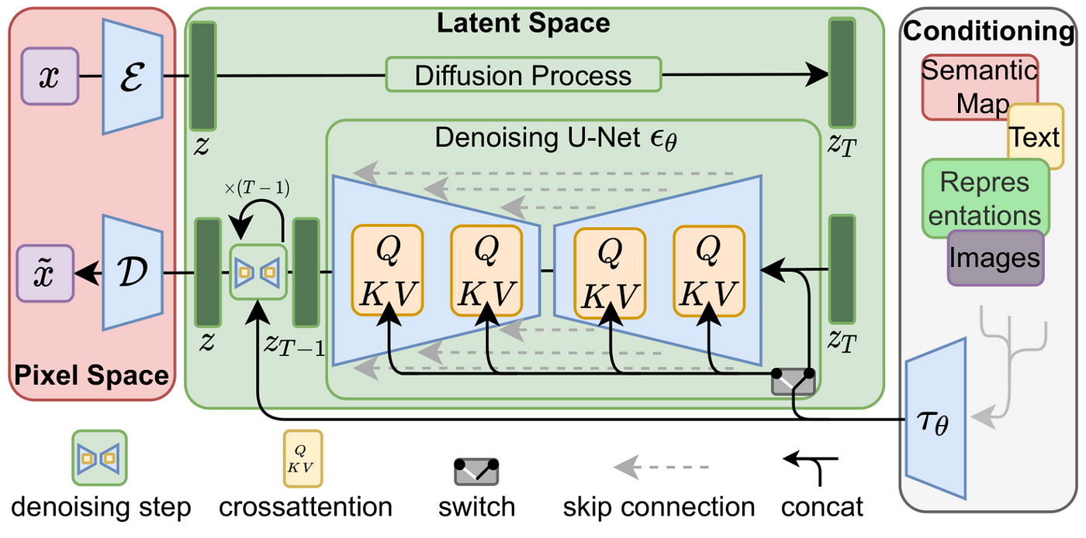
Diffusion的框架

Slide 14
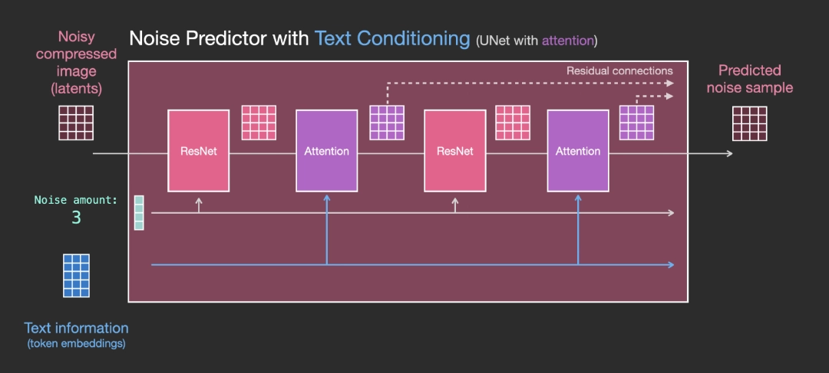
Diffusion张量级别操作

Slide 15
How diffusion denoising
structurally?
prompt
Token
Image
Decoder
Embeds
Denoising
Latent
Noise
scheduler
Timestep

Slide 16
DDPM code example
scheduler.set_timesteps(50)
scheduler.timesteps tensor([980, 960, 940, 920, 900, 880, 860, 840, 820, 800, 780, 760, 740, 720, 700, 680, 660, 640, 620, 600, 580, 560, 540, 520, 500, 480, 460, 440, 420, 400, 380, 360, 340, 320, 300, 280, 260, 240, 220, 200, 180, 160, 140, 120, 100, 80, 60, 40, 20, 0])
noise = torch.randn((1, 3, sample_size, sample_size), device="cuda")
input = noise
for t in scheduler.timesteps:
... with torch.no_grad():
... noisy_residual = model(input, t).sample
... previous_noisy_sample = scheduler.step(noisy_residual, t, input).prev_sample
... input = previous_noisy_sample
image = (input / 2 + 0.5).clamp(0, 1).squeeze()
image = (image.permute(1, 2, 0) * 255).round().to(torch.uint8).cpu().numpy()
image = Image.fromarray(image)

Slide 17
Diffusion
Vision
Generation
Classification
Segmentation
Image Translation
Inverse Problems
Medical Imaging
Multi-modal Learning
3D Vision
Adversarial Attack
Miscellany
Audio
Language
Tabular & Time
Graph
Reinforcement Learning

Slide 18
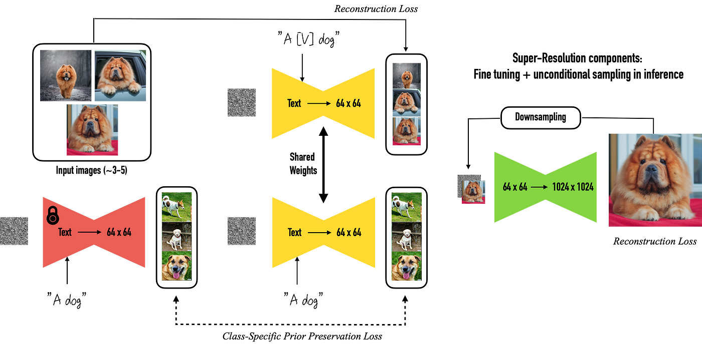
DreamBooth

Slide 19
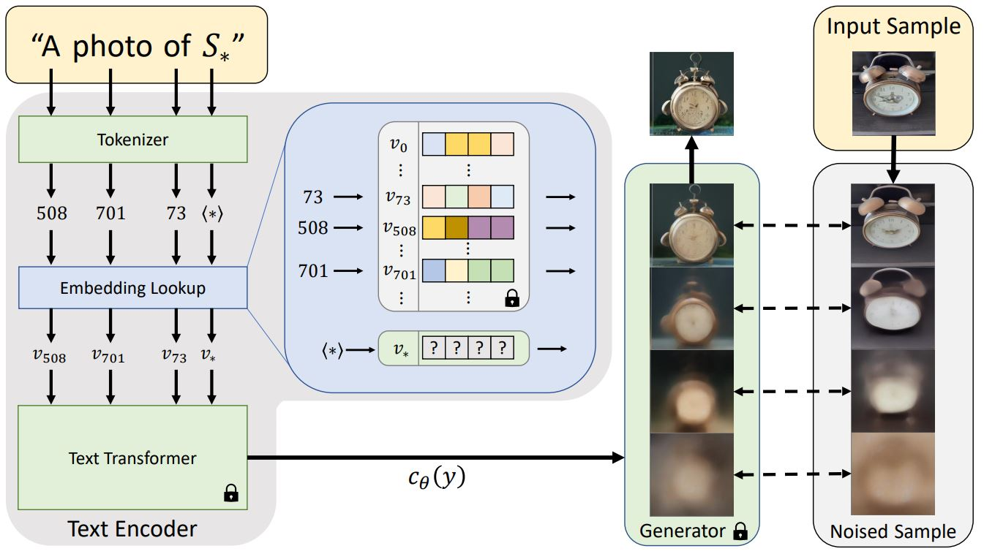
Textual Inversion

Slide 20
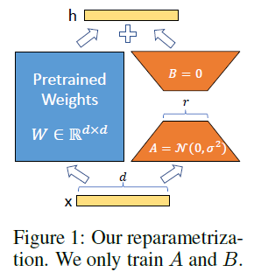
LoRA：Low-rank adaptation of large language models
input_dim = 768 # e.g., the hidden size of the pre-trained model output_dim = 768 # e.g., the output size of the layer
rank = 8 # The rank 'r' for the low-rank adaptation
W = ... # from pretrained network with shape input_dim x output_dim
W_A = nn.Parameter(torch.empty(input_dim, rank)) # LoRA weight A
W_B = nn.Parameter(torch.empty(rank, output_dim)) # LoRA weight B # Initialization of LoRA weights
nn.init.kaiming_uniform_(W_A, a=math.sqrt(5))
nn.init.zeros_(W_B)
def regular_forward_matmul(x, W):
h = x @ W
return h
def lora_forward_matmul(x, W, W_A, W_B):
h = x @ W # regular matrix multiplication
h += x @ (W_A @ W_B)*alpha # use scaled LoRA weights
return h

Slide 21
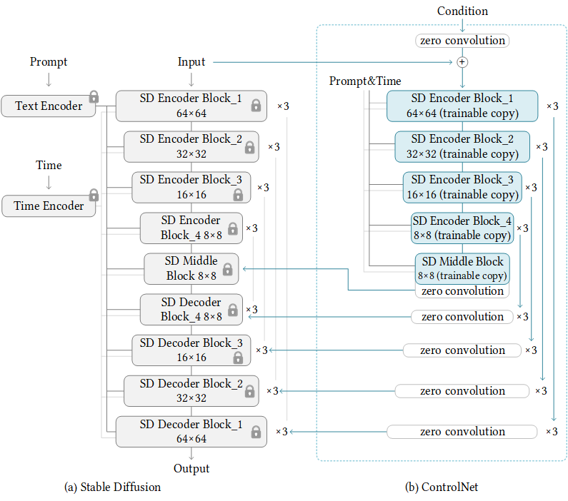
ControlNet
zero convolution
避免破坏预训练模型：zero convolution的初始化权重为零，确保初始状态下不会改变原有的模型输出，稳定原有的生成效果。
逐渐学习条件信息：在训练过程中，zero convolution的权重会逐渐更新，使模型学会如何利用额外的条件信息来控制生成结果。
为什么encoder的内容不直接传回
分离路径：ControlNet通过增加条件控制路径，与原有的Stable Diffusion模型路径保持分离，避免直接干扰。
渐进式调整：通过逐步在每个Block后应用zero convolution，模型可以逐步学习和调整，避免一次性的大幅修改导致不稳定的生成效果。

Slide 22
That’s all.
Thank you all guys!
😚
👋

